Slide 1
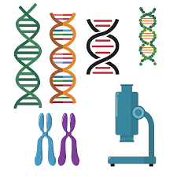
YOUR CHALLENGE
Make your own DNA strand

Slide 2
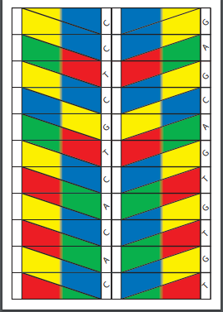
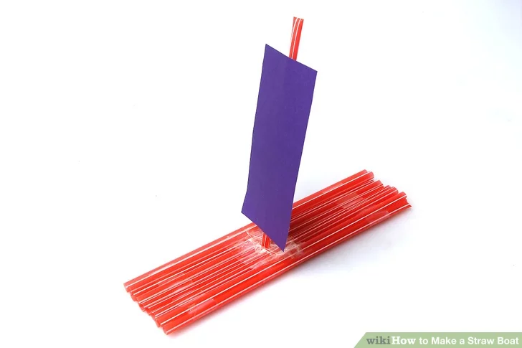
STEP 1
Print your DNA template

Slide 3
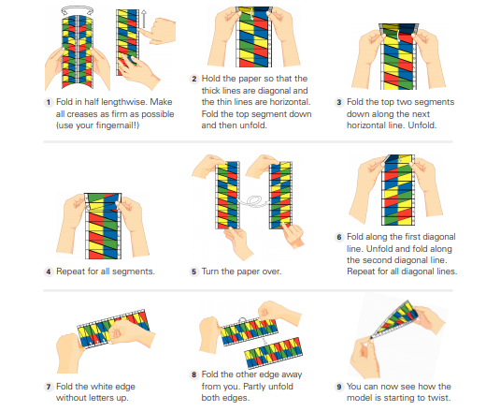
STEP 2
Follow the instructions carefully

Slide 4
STEP 3
Take a photo
Take a photo of your finished DNA double helix strand and send it to us.
!

Slide 5
STEP 4
What is DNA ?
DNA is an essential molecule for life. It acts like a recipe holding the instructions telling our bodies how to develop and function. What does DNA stand for? DNA is short for deoxyribonucleic acid.
Different Cells in the Body Our bodies have around 210 different types of cells. Each cell does a different job to help our body to function. There are blood cells, bone cells, and cells that make our muscles.
How do cells know what to do? Cells get their instructions on what do to from DNA. DNA acts sort of like a computer program. The cell is the computer or the hardware and the DNA is the program or code.

Slide 6
Send us a picture of your project
@ Sentinus
@ SentinusNi
@ Sentinus_ni

Slide 7
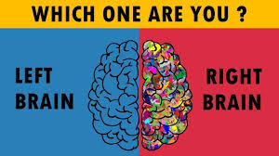
YOUR CHALLENGE
Are you left or right brained?
In this activity, you will get to find out whether you have a sidedness — that is, whether you prefer to do activities with one side of your body — and what that might say about your brain.

Slide 8
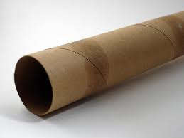
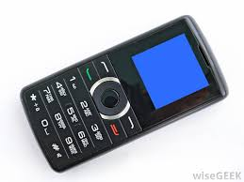
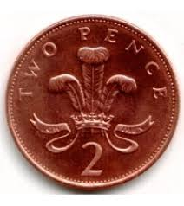
STEP 1
Gather Your Materials

Slide 9
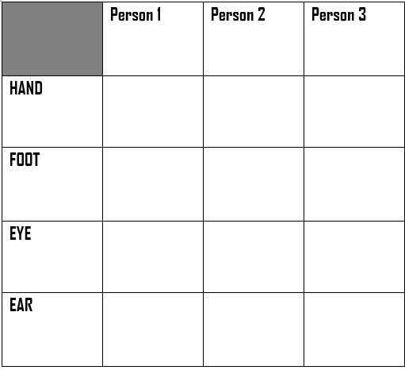
STEP 2
Make your results table

Slide 10
STEP 3
Get to work!
Get your first volunteer ready:
Ask them to :
Write their name on a piece of paper (which hand did they use?)
Place a coin on the floor directly in front of them and ask them to step on the coin (which foot did they use to step on the coin?)
Give them your empty paper towel tube and ask them to look at an object through it (which eye do they use to look through the tube?)
Give them a phone and ask them to listen to it (which ear do they put the phone up to?)
Record all of your results in the table you made, write left or right in the correct place after each task is completed
Now try it with someone else
Can you think of your own tasks to add to the table and ask people to do?
Look at your results table, are more of your volunteers right-handed or left-handed? What about right-footed versus left-footed, right-eyed versus left-eyed, and right-eared versus left-eared?

Slide 11
STEP 4
What happened ?
Most scientific studies find that between 70% and 90% of people are right-handed. From this activity, you probably saw that most people who are right-handed are also right-sided overall. That is, they usually prefer to use their right foot, eye, and ear as well.
The same trend exists with left-handed people. A person who is left-handed is more likely to also be left-footed, left-eyed, and left-eared.
A person's preference for using either their right or left side for each task develops during childhood. But sometimes how a child is taught to do a task can overrule their preferences.

Slide 12
Send us a picture of your project
@ Sentinus
@ SentinusNi
@ Sentinus_ni

Slide 13
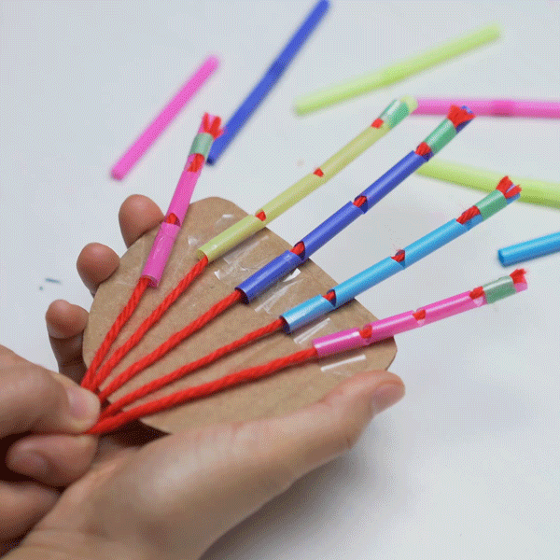
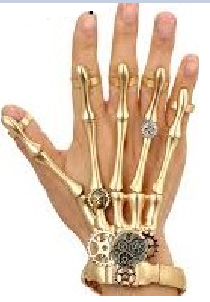
YOUR CHALLENGE
Make your own Skeleton hand

Slide 14
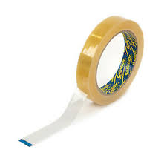
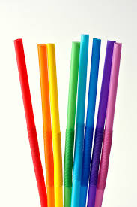
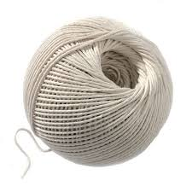
STEP 1
Gather Your Materials

Slide 15
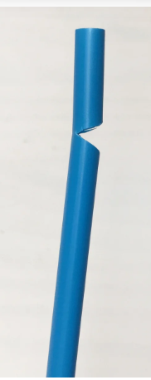
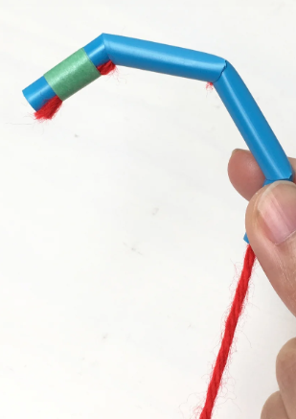
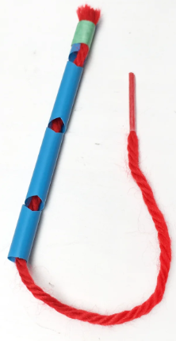
STEP 2
Get to work!
1. Use your scissors to make angled cuts on a straw.
Tip: Make sure the straw is still intact and that you're not cutting all the way through the straw.
2. Repeat step one two more times. Try spacing out the cuts to imitate the joints in your finger!
3. Cut the string just a bit longer than the straw and thread it through the straw. Tape one end of the string to the end of the straw.
4. On the other end, pull on the excess string and watch your straw finger curl

Slide 16
STEP 3
Now complete your hand
How many more fingers can you create?
Challenge yourself by making a straw hand using your cardboard - you might even be able to pick something up or catch something with your hand mechanism!

Slide 17
Send us a picture of your project
@ Sentinus
@ SentinusNi
@ Sentinus_ni

